Slide 1
Tourism in Scotland – At a crossroads
Tourism in Scotland….
Employs 229,000 people ( 1 in 12)
3.5 Million International Visitors
13.8 Million Domestic Visitors
133 Million Day Visitors
Industry turnover £7.7 Billion
All figures as of 2019

Slide 2
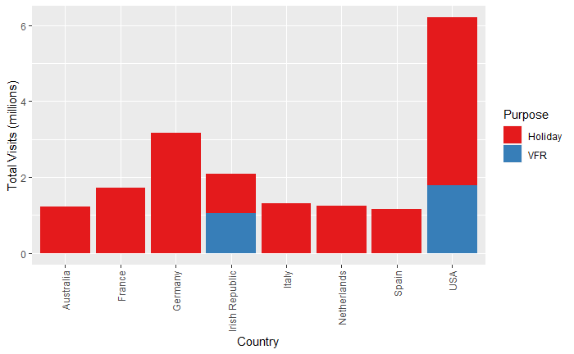
Where do our visitors come from?

Slide 3
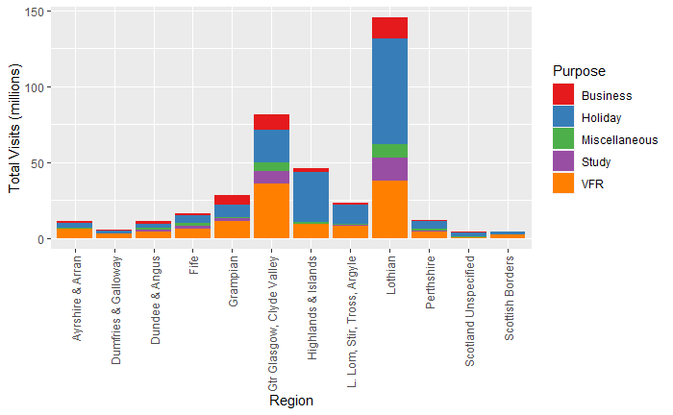
Where do they go?

Slide 4
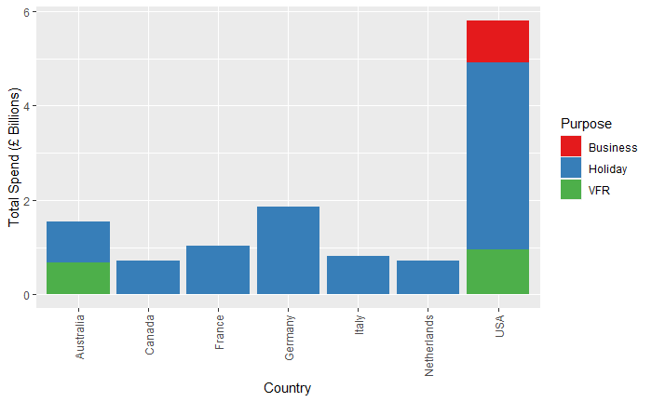
Who spends the most?

Slide 5
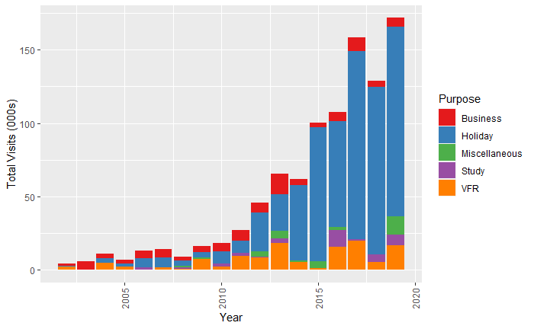
Fastest Growth?

Slide 6
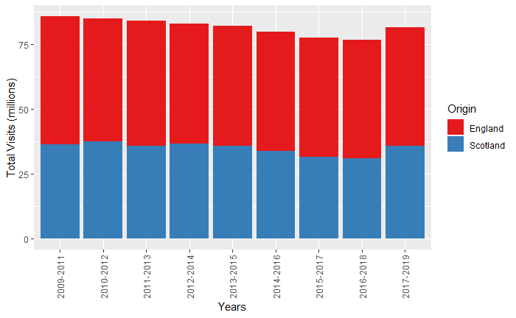
Domestic – Overnight Stays

Slide 7
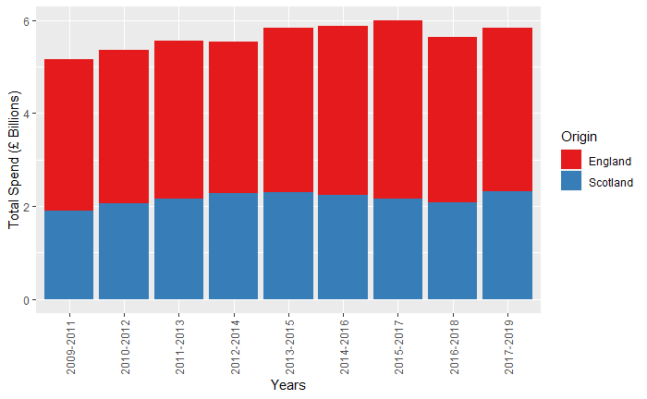
Domestic – Spending

Slide 8
Domestic Tourism – The Staycation myth
Since the Covid Pandemic
Visitor numbers are down by 80%
Even higher fall in spending, 85%
Hiring a campervan doesn’t create jobs
Unless you make campervans
Any questions?

